Slide 1



Cryptography and Network Security
Seventh Edition, Global Edition
by William Stallings
Notes:
Lecture slides prepared for “Cryptography and Network Security”, 7/e, by William Stallings, Chapter 6 – “Advanced Encryption Standard”.

Slide 2
Chapter 6
Advanced Encryption Standard
Notes:
The Advanced Encryption Standard (AES) was published by the National Institute
of Standards and Technology (NIST) in 2001. AES is a symmetric block cipher that
is intended to replace DES as the approved standard for a wide range of applications.
Compared to public-key ciphers such as RSA, the structure of AES and most symmetric
ciphers is quite complex and cannot be explained as easily as many other cryptographic
algorithms. Accordingly, the reader may wish to begin with a simplified version
of AES, which is described in Appendix 5B. This version allows the reader to perform
encryption and decryption by hand and gain a good understanding of the working of
the algorithm details. Classroom experience indicates that a study of this simplified
version enhances understanding of AES. One possible approach is to read the chapter
first, then carefully read Appendix W, and then re-read the main body of the chapter.
Appendix H looks at the evaluation criteria used by NIST to select from among
the candidates for AES, plus the rationale for picking Rijndael, which was the winning
candidate. This material is useful in understanding not just the AES design but also the
criteria by which to judge any symmetric encryption algorithm.

Slide 3
Difference Between DES and AES
DES | AES
Bit-Oriented. | Byte-Oriented.
The key is of 56-bit size. | The key is of different sizes such as 128-bits, 192-bits, and so on
DES involves 16 rounds of identical operations | Number of rounds depends on key length: 10(128-bits), 12(192-bits), or 14(256-bits)
Used to encrypt plain text of 64-bit | Used to encrypt plain text of 128-bit
It can be broken by brute force attacks | To date, AES has not been attacked
It is based on Feistel network | It is based on permutation and substitution network

Slide 4
Difference Between DES and AES
DES | AES
The rounds in DES are: Expansion, XOR operation with round key, Substitution and Permutation | The rounds in AES are: Byte Substitution, Shift Row, Mix Column and Key Addition
DES cipher is derived from Lucifer cipher. | AES cipher is derived from an aside-channel square cipher.
It is slower than AES. | It is faster than DES.
Less secure than AES | More secure than DES
It is efficient only with hardware. | It is efficient with both hardware and software.

Slide 5
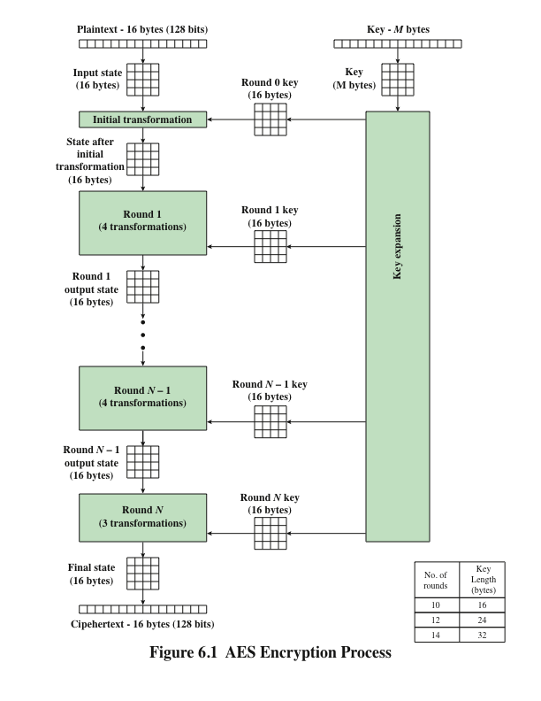
Notes:
Figure 6.1 shows the overall structure of the AES encryption process. The cipher
takes a plaintext block size of 128 bits, or 16 bytes. The key length can be 16, 24, or
32 bytes (128, 192, or 256 bits). The algorithm is referred to as AES-128, AES-192, or
AES-256, depending on the key length.

Slide 6
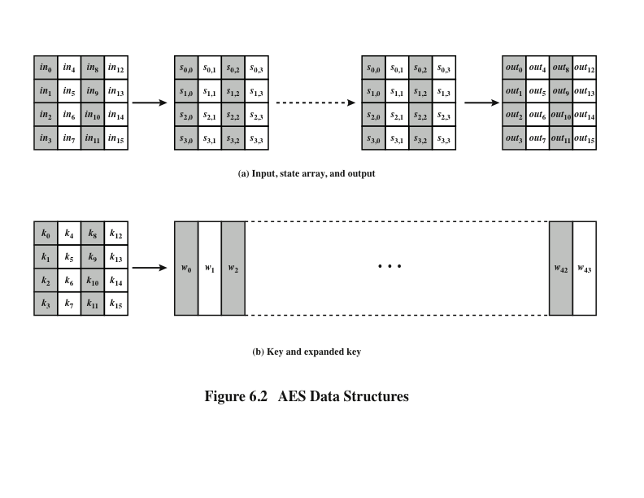
Notes:
The input to the encryption and decryption algorithms is a single 128-bit block.
In FIPS PUB 197, this block is depicted as a 4 * 4 square matrix of bytes. This
block is copied into the State array, which is modified at each stage of encryption or
decryption. After the final stage, State is copied to an output matrix. These operations
are depicted in Figure 6.2a. Similarly, the key is depicted as a square matrix of bytes.
This key is then expanded into an array of key schedule words. Figure 6.2b shows the
expansion for the 128-bit key. Each word is four bytes, and the total key schedule
is 44 words for the 128-bit key. Note that the ordering of bytes within a matrix is by
column. So, for example, the first four bytes of a 128-bit plaintext input to the encryption
cipher occupy the first column of the in matrix, the second four bytes occupy the
second column, and so on. Similarly, the first four bytes of the expanded key, which
form a word, occupy the first column of the w matrix.

Slide 7
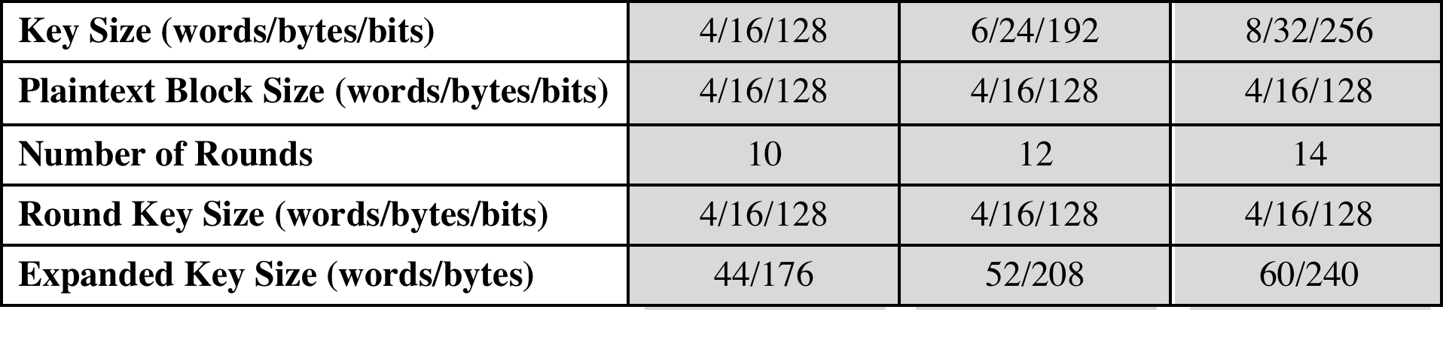
Table 6.1 AES Parameters
Notes:
The cipher consists of N rounds, where the number of rounds depends on the
key length: 10 rounds for a 16-byte key, 12 rounds for a 24-byte key, and 14 rounds
for a 32-byte key (Table 6.1). The first N - 1 rounds consist of four distinct transformation
functions: SubBytes, ShiftRows, MixColumns, and AddRoundKey, which are
described subsequently. The final round contains only three transformations, and
there is a initial single transformation (AddRoundKey) before the first round, which
can be considered Round 0. Each transformation takes one or more 4 * 4 matrices
as input and produces a 4 * 4 matrix as output. Figure 6.1 shows that the output of
each round is a 4 * 4 matrix, with the output of the final round being the ciphertext.
Also, the key expansion function generates N + 1 round keys, each of which is a distinct
4 * 4 matrix. Each round key serves as one of the inputs to the AddRoundKey
transformation in each round.

Slide 8
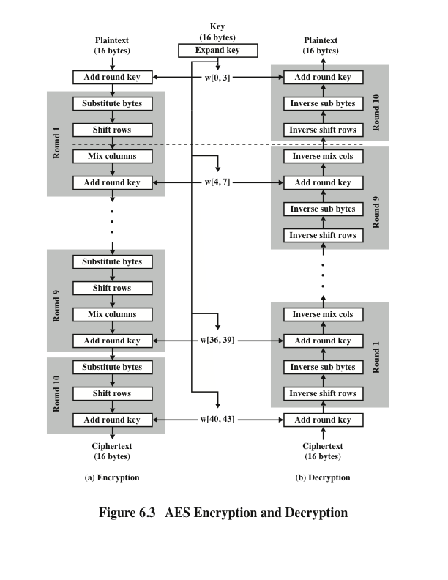
Notes:
Figure 6.3 shows the AES cipher in more detail, indicating the sequence of transformations
in each round and showing the corresponding decryption function. As was
done in Chapter 4, we show encryption proceeding down the page and decryption
proceeding up the page.

Slide 9
Detailed Structure
Processes the entire data block as a single matrix during each round using substitutions and permutation
The key that is provided as input is expanded into an array of forty-four 32-bit words, w[i]
The cipher begins and ends with an AddRoundKey stage
Can view the cipher as alternating operations of XOR encryption (AddRoundKey) of a block, followed by scrambling of the block (the other three stages), followed by XOR encryption, and so on
Each stage is easily reversible
The decryption algorithm makes use of the expanded key in reverse order, however the decryption algorithm is not identical to the encryption algorithm
State is the same for both encryption and decryption
Final round of both encryption and decryption consists of only three stages
Notes:
Before delving into details, we can make several comments about the overall
AES structure.
1. One noteworthy feature of this structure is that it is not a Feistel structure.
Recall that, in the classic Feistel structure, half of the data block is used to
modify the other half of the data block and then the halves are swapped. AES
instead processes the entire data block as a single matrix during each round
using substitutions and permutation.
2. The key that is provided as input is expanded into an array of forty-four 32-bit
words, w [i ]. Four distinct words (128 bits) serve as a round key for each round;
these are indicated in Figure 6.3.
3. Four different stages are used, one of permutation and three of substitution:
• Substitute bytes: Uses an S-box to perform a byte-by-byte substitution of
the block
• ShiftRows: A simple permutation
• MixColumns: A substitution that makes use of arithmetic over GF(2⁸ )
• AddRoundKey: A simple bitwise XOR of the current block with a portion
of the expanded key
4. The structure is quite simple. For both encryption and decryption, the
cipher begins with an AddRoundKey stage, followed by nine rounds that each
includes all four stages, followed by a tenth round of three stages.
5. Only the AddRoundKey stage makes use of the key. For this reason, the cipher
begins and ends with an AddRoundKey stage. Any other stage, applied at the
beginning or end, is reversible without knowledge of the key and so would add
no security.
6. The AddRoundKey stage is, in effect, a form of Vernam cipher and by itself
would not be formidable. The other three stages together provide confusion,
diffusion, and nonlinearity, but by themselves would provide no security
because they do not use the key. We can view the cipher as alternating operations
of XOR encryption (AddRoundKey) of a block, followed by scrambling
of the block (the other three stages), followed by XOR encryption, and so on.
This scheme is both efficient and highly secure.
7. Each stage is easily reversible. For the Substitute Byte, ShiftRows, and
MixColumns stages, an inverse function is used in the decryption algorithm.
For the AddRoundKey stage, the inverse is achieved by XORing the same
round key to the block.
8. As with most block ciphers, the decryption algorithm makes use of the
expanded key in reverse order. However, the decryption algorithm is not
identical to the encryption algorithm. This is a consequence of the particular
structure of AES.
9. Once it is established that all four stages are reversible, it is easy to verify
that decryption does recover the plaintext. Figure 6.3 lays out encryption
and decryption going in opposite vertical directions. At each horizontal point
(e.g., the dashed line in the figure), State is the same for both encryption and
decryption.
10. The final round of both encryption and decryption consists of only three stages.
Again, this is a consequence of the particular structure of AES and is required
to make the cipher reversible.

Slide 10
Detailed Structure
Four different stages are used:
Substitute bytes – uses an S-box to perform a byte-by-byte substitution of the block
ShiftRows – a simple permutation
MixColumns – a substitution that makes use of arithmetic over GF(2⁸)
AddRoundKey – a simple bitwise XOR of the current block with a portion of the expanded key
Notes:
The finite field with p^{n} elements is denoted GF(p^{n}) and is also called the Galois field of order p^{n}

Slide 11
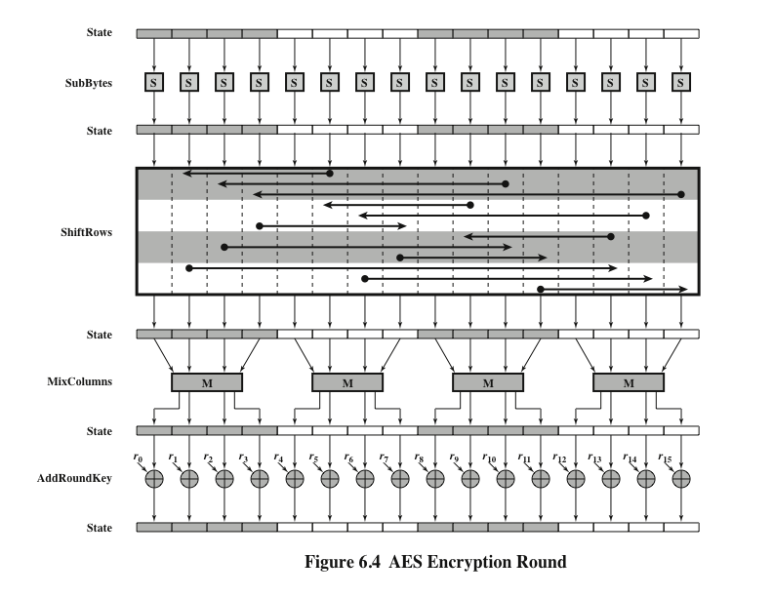
Notes:
Figure 6.4 depicts the structure of a full encryption round.

Slide 12
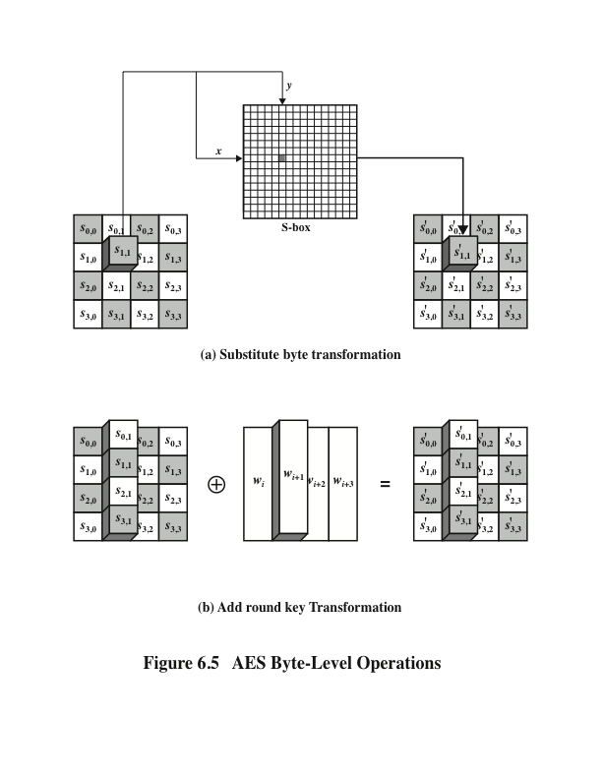
Notes:
The forward substitute byte transformation , called SubBytes, is a simple table lookup (Figure 6.5a).

Slide 13
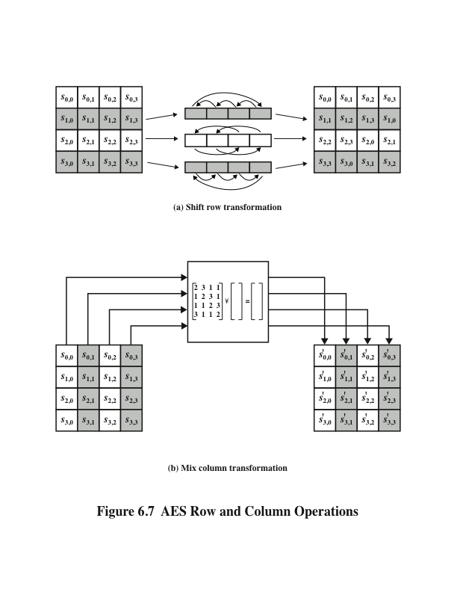
Notes:
The forward shift row transformation ,
called ShiftRows, is depicted in Figure 6.7a. The first row of State is not altered. For
the second row, a 1-byte circular left shift is performed. For the third row, a 2-byte
circular left shift is performed. For the fourth row, a 3-byte circular left shift is performed.
The following is an example of ShiftRows.
The inverse shift row transformation , called InvShiftRows, performs the circular
shifts in the opposite direction for each of the last three rows, with a 1-byte
circular right shift for the second row, and so on.
The forward mix column transformation,
called MixColumns, operates on each column individually. Each byte of a column
is mapped into a new value that is a function of all four bytes in that column. The
transformation can be defined by the following matrix multiplication on State
(Figure 6.7b)
Each element in the product matrix is the sum of products of elements of one row
and one column. In this case, the individual additions and multiplications are
performed in GF(2⁸ ).

Slide 14
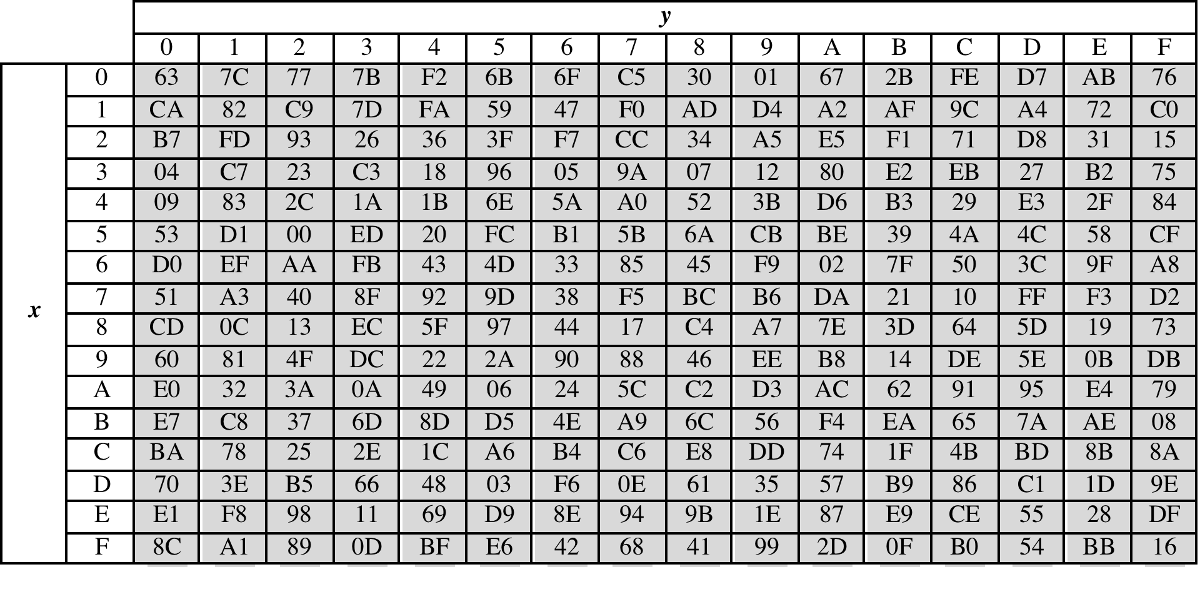
Table 6.2
(a) S-box
(Table can be found on page 163 in textbook)
Notes:
AES defines a 16 * 16 matrix of byte values, called an S-box (Table 6.2a), that contains
a permutation of all possible 256 8-bit values. Each individual byte of State
is mapped into a new byte in the following way: The leftmost 4 bits of the byte
are used as a row value and the rightmost 4 bits are used as a column value.
These row and column values serve as indexes into the S-box to select a unique
8-bit output value. For example, the hexadecimal value {95} references row 9,
column 5 of the S-box, which contains the value {2A}. Accordingly, the value {95}
is mapped into the value {2A}.

Slide 15
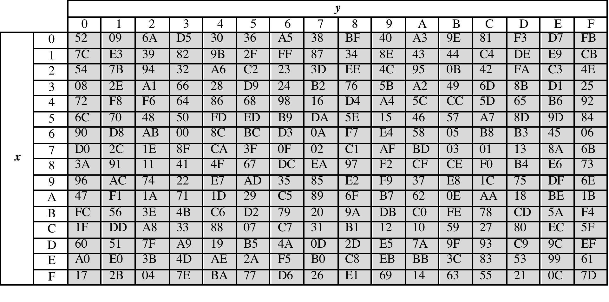
Table 6.2
(b) Inverse S-box
(Table can be found on page 163 in textbook)
Notes:
The inverse substitute byte transformation , called InvSubBytes, makes use
of the inverse S-box shown in Table 6.2b.

Slide 16
S-Box Rationale
The S-box is designed to be resistant to known cryptanalytic attacks
The Rijndael developers sought a design that has a low correlation between input bits and output bits and the property that the output is not a linear mathematical function of the input
The nonlinearity is due to the use of the multiplicative inverse
Notes:
The S-box is designed to be resistant to known cryptanalytic attacks.
Specifically, the Rijndael developers sought a design that has a low correlation
Between input bits and output bits and the property that the output is not a linear
mathematical function of the input [DAEM01]. The nonlinearity is due to the use
of the multiplicative inverse.

Slide 17
Shift Row Rationale
The State, as well as the cipher input and output, is treated as an array of four 4-byte columns
On encryption, the first 4 bytes of the plaintext are copied to the first column of State, and so on
The round key is applied to State column by column
Thus, a row shift moves an individual byte from one column to another, which is a linear distance of a multiple of 4 bytes
Transformation ensures that the 4 bytes of one column are spread out to four different columns
Notes:
The shift row transformation is more substantial than it may first
appear. This is because the State , as well as the cipher input and output, is
treated as an array of four 4-byte columns. Thus, on encryption, the first 4 bytes
of the plaintext are copied to the first column of State , and so on. Furthermore,
as will be seen, the round key is applied to State column by column. Thus, a row
shift moves an individual byte from one column to another, which is a linear
distance of a multiple of 4 bytes. Also note that the transformation ensures that
the 4 bytes of one column are spread out to four different columns. Figure 6.4
illustrates the effect.

Slide 18
Mix Columns Rationale
Coefficients of a matrix based on a linear code with maximal distance between code words ensures a good mixing among the bytes of each column
The mix column transformation combined with the shift row transformation ensures that after a few rounds all output bits depend on all input bits
Notes:
The coefficients of the matrix in Equation (6.3) are based on a linear
code with maximal distance between code words, which ensures a good mixing
among the bytes of each column. The mix column transformation combined with
the shift row transformation ensures that after a few rounds all output bits depend
on all input bits. See [DAEM99] for a discussion.
In addition, the choice of coefficients in MixColumns, which are all {01}, { 02},
or { 03}, was influenced by implementation considerations. As was discussed, multiplication
by these coefficients involves at most a shift and an XOR. The coefficients
in InvMixColumns are more formidable to implement. However, encryption was
deemed more important than decryption for two reasons:
1. For the CFB and OFB cipher modes (Figures 7.5 and 7.6; described in Chapter 7),
only encryption is used.
2. As with any block cipher, AES can be used to construct a message authentication
code (Chapter 13), and for this, only encryption is used.

Slide 19
AddRoundKey Transformation
The 128 bits of State are bitwise XORed with the 128 bits of the round key
Operation is viewed as a columnwise operation between the 4 bytes of a State column and one word of the round key
Can also be viewed as a byte-level operation
Rationale:
Is as simple as possible and affects every bit of State
The complexity of the round key expansion plus the complexity of the other stages of AES ensure security
Notes:
In the forward add round key transformation ,
called AddRoundKey, the 128 bits of State are bitwise XORed with the 128
bits of the round key. As shown in Figure 6.5b, the operation is viewed as a columnwise
operation between the 4 bytes of a State column and one word of the round
key; it can also be viewed as a byte-level operation.
The add round key transformation is as simple as possible and affects
every bit of State . The complexity of the round key expansion, plus the complexity
of the other stages of AES, ensure security.

Slide 20
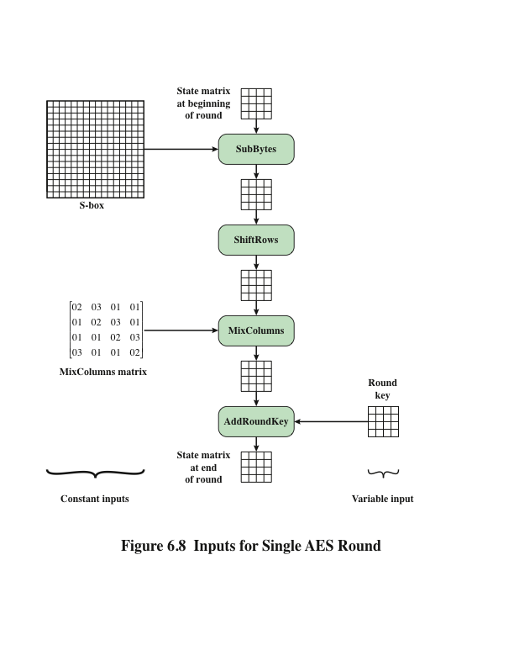
Notes:
Figure 6.8 is another view of a single round of AES, emphasizing the mechanisms
and inputs of each transformation.

Slide 21
AES Key Expansion
Takes as input a four-word (16 byte) key and produces a linear array of 44 words (176) bytes
This is sufficient to provide a four-word round key for the initial AddRoundKey stage and each of the 10 rounds of the cipher
Key is copied into the first four words of the expanded key
The remainder of the expanded key is filled in four words at a time
Each added word w[i] depends on the immediately preceding word, w[i – 1], and the word four positions back, w[i – 4]
In three out of four cases a simple XOR is used
For a word whose position in the w array is a multiple of 4, a more complex function is used
Notes:
The AES key expansion algorithm takes as input a four-word (16-byte) key and
produces a linear array of 44 words (176 bytes). This is sufficient to provide a four word
round key for the initial AddRoundKey stage and each of the 10 rounds of the
cipher. The pseudocode on the next page describes the expansion.
The key is copied into the first four words of the expanded key. The remainder
of the expanded key is filled in four words at a time. Each added word w [i]
depends on the immediately preceding word, w [i - 1], and the word four positions
back, w [i - 4]. In three out of four cases, a simple XOR is used. For a word whose
position in the w array is a multiple of 4, a more complex function is used.

Slide 22
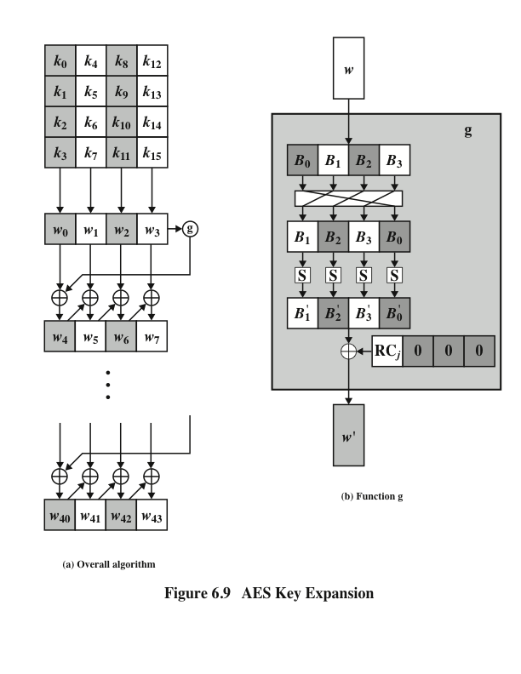
Notes:
Figure 6.9 illustrates the generation of the expanded key, using the symbol g to represent that
complex function.

Slide 23
Key Expansion Rationale
The specific criteria that were used are:
Knowledge of a part of the cipher key or round key does not enable calculation of many other round-key bits
An invertible transformation
Speed on a wide range of processors
Usage of round constants to eliminate symmetries
Diffusion of cipher key differences into the round keys
Enough nonlinearity to prohibit the full determination of round key differences from cipher key differences only
Simplicity of description
The Rijndael developers designed the expansion key algorithm to be resistant to known cryptanalytic attacks
Inclusion of a round-dependent round constant eliminates the symmetry between the ways in which round keys are generated in different rounds
Notes:
The Rijndael developers designed the expansion key algorithm to be resistant to
known cryptanalytic attacks. The inclusion of a round-dependent round constant
eliminates the symmetry, or similarity, between the ways in which round keys are
generated in different rounds. The specific criteria that were used are [DAEM99]
• Knowledge of a part of the cipher key or round key does not enable calculation
of many other round-key bits.
• An invertible transformation [i.e., knowledge of any Nk consecutive words of
the expanded key enables regeneration of the entire expanded key (Nk = key
size in words)].
• Speed on a wide range of processors.
• Usage of round constants to eliminate symmetries.
• Diffusion of cipher key differences into the round keys; that is, each key bit
affects many round key bits.
• Enough nonlinearity to prohibit the full determination of round key differences
from cipher key differences only.
• Simplicity of description.
The authors do not quantify the first point on the preceding list, but the idea
is that if you know less than Nk consecutive words of either the cipher key or one of
the round keys, then it is difficult to reconstruct the remaining unknown bits. The
fewer bits one knows, the more difficult it is to do the reconstruction or to determine
other bits in the key expansion.

Slide 24
Equivalent Inverse Cipher
AES decryption cipher is not identical to the encryption cipher
The sequence of transformations differs although the form of the key schedules is the same
Has the disadvantage that two separate software modules are needed for applications that require both encryption and decryption
Two separate changes are needed to bring the decryption structure in line with the encryption structure
The first two stages of the decryption round need to be interchanged
The second two stages of the decryption round need to be interchanged
Notes:
As was mentioned, the AES decryption cipher is not identical to the encryption
cipher (Figure 6.3). That is, the sequence of transformations for decryption differs
from that for encryption, although the form of the key schedules for encryption
and decryption is the same. This has the disadvantage that two separate software
or firmware modules are needed for applications that require both encryption and
decryption. There is, however, an equivalent version of the decryption algorithm
that has the same structure as the encryption algorithm. The equivalent version has
the same sequence of transformations as the encryption algorithm (with transformations
replaced by their inverses). To achieve this equivalence, a change in key
schedule is needed.
Two separate changes are needed to bring the decryption structure in line
with the encryption structure. As illustrated in Figure 6.3, an encryption round has
the structure SubBytes, ShiftRows, MixColumns, AddRoundKey. The standard
decryption round has the structure InvShiftRows, InvSubBytes, AddRoundKey,
InvMixColumns. Thus, the first two stages of the decryption round need to
be interchanged, and the second two stages of the decryption round need to be
interchanged.

Slide 25
Interchanging InvShiftRows and InvSubBytes
InvShiftRows affects the sequence of bytes in State but does not alter byte contents and does not depend on byte contents to perform its transformation
InvSubBytes affects the contents of bytes in State but does not alter byte sequence and does not depend on byte sequence to perform its transformation
Thus, these two operations commute and can be interchanged
Notes:
InvShiftRows affects the
sequence of bytes in State but does not alter byte contents and does not depend
on byte contents to perform its transformation. InvSubBytes affects the contents
of bytes in State but does not alter byte sequence and does not depend on byte
sequence to perform its transformation. Thus, these two operations commute and
can be interchanged.

Slide 26
Interchanging AddRoundKey and InvMixColumns
The transformations AddRoundKey and InvMixColumns do not alter the sequence of bytes in State
If we view the key as a sequence of words, then both AddRoundKey and InvMixColumns operate on State one column at a time
These two operations are linear with respect to the column input
Notes:
The transformations
AddRoundKey and InvMixColumns do not alter the sequence of bytes in State . If we
view the key as a sequence of words, then both AddRoundKey and InvMixColumns
operate on State one column at a time. These two operations are linear with respect
to the column input.

Slide 27
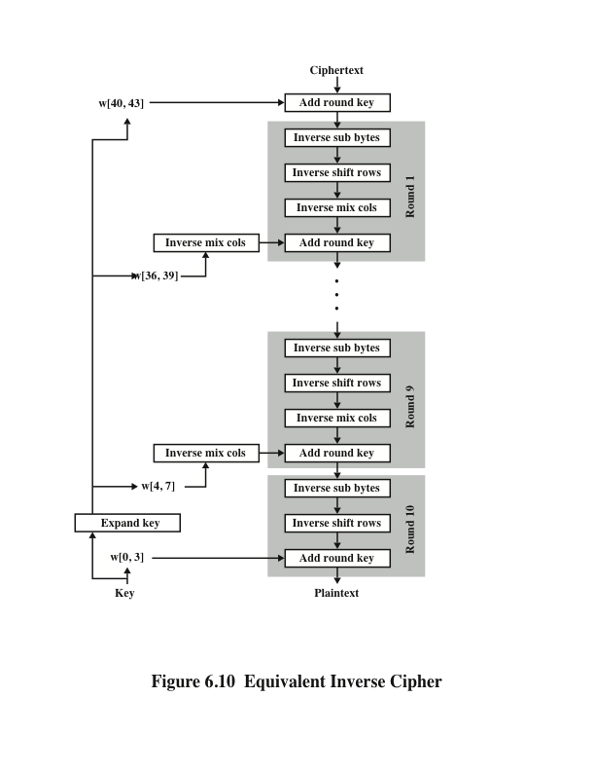
Notes:
Figure 6.10 illustrates the equivalent decryption algorithm.

Slide 28
Implementation Aspects
AddRoundKey is a bytewise XOR operation
ShiftRows is a simple byte-shifting operation
SubBytes operates at the byte level and only requires a table of 256 bytes
MixColumns requires matrix multiplication in the field GF(2⁸), which means that all operations are carried out on bytes
Notes:
The Rijndael proposal [DAEM99] provides some suggestions for efficient implementation
on 8-bit processors, typical for current smart cards, and on 32-bit processors,
typical for PCs.
AES can be implemented very efficiently on an 8-bit processor.
AddRoundKey is a bytewise XOR operation. ShiftRows is a simple byteshifting
operation. SubBytes operates at the byte level and only requires a table of
256 bytes.
The transformation MixColumns requires matrix multiplication in the field
GF(2⁸ ), which means that all operations are carried out on bytes. MixColumns only
requires multiplication by {02} and {03}, which, as we have seen, involved simple
shifts, conditional XORs, and XORs. This can be implemented in a more efficient
way that eliminates the shifts and conditional XORs.

Slide 29
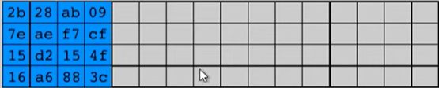
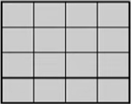
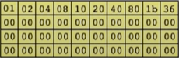
Key Schedule
…
Round Constant

Slide 30
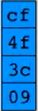
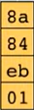
Key Schedule
…
Rotate Word
Sub Bytes

Slide 31
Key Schedule
…
Round Constant

Slide 32
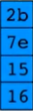
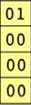
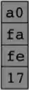

Key Schedule
…
Round Constant

Slide 33
Key Schedule
…
Round Constant

Slide 34
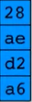
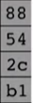
Key Schedule
…
Round Constant

Slide 35
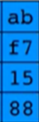
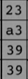
Key Schedule
…
Round Constant

Slide 36
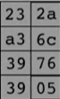
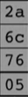
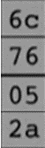
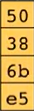
Key Schedule
…
Rotate
Sub-bytes
Round Constant

Slide 37
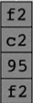
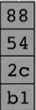
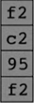
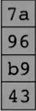
Key Schedule
…

Slide 38
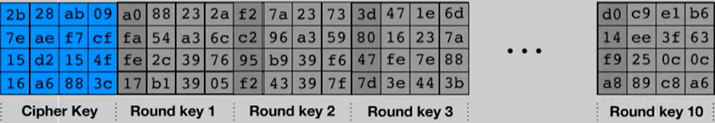

Slide 39
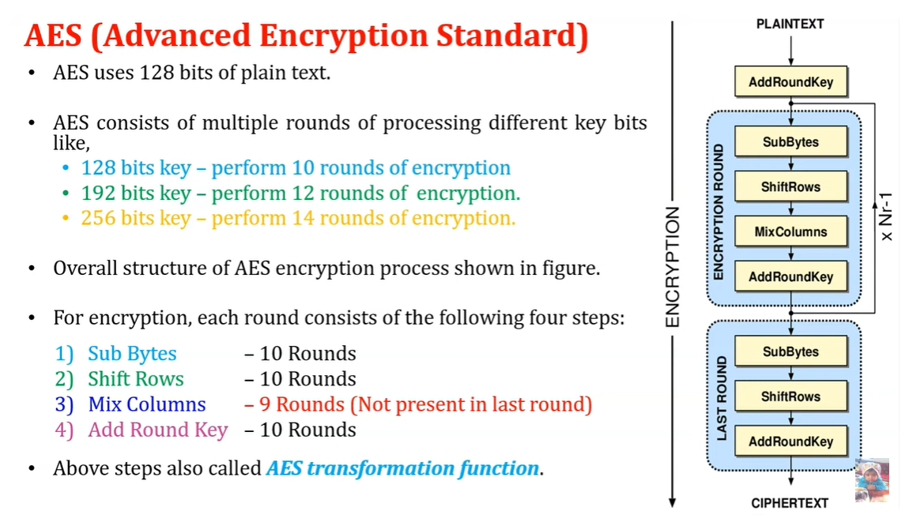

Slide 40
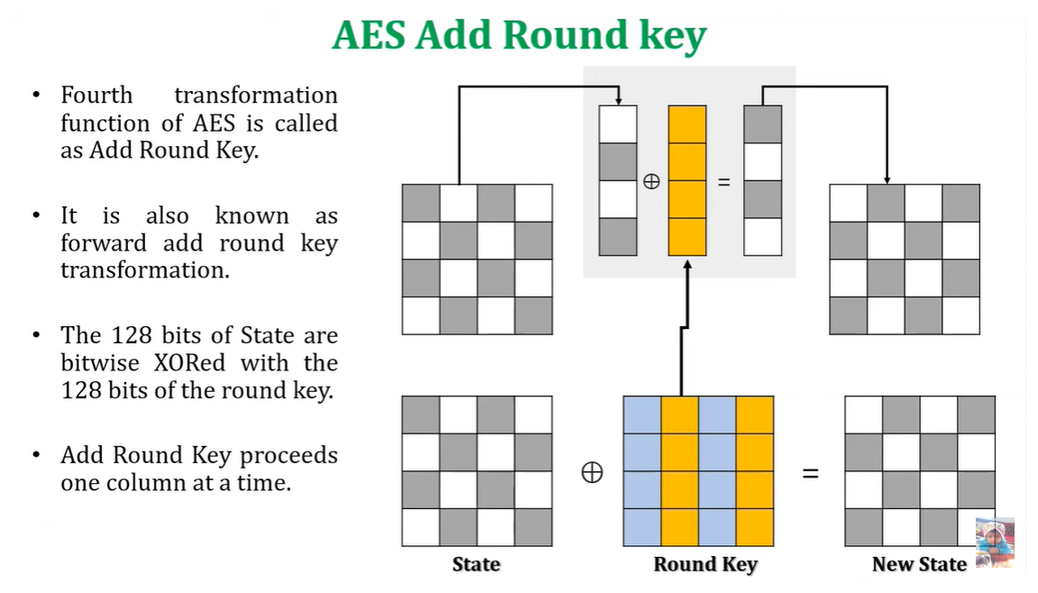

Slide 41
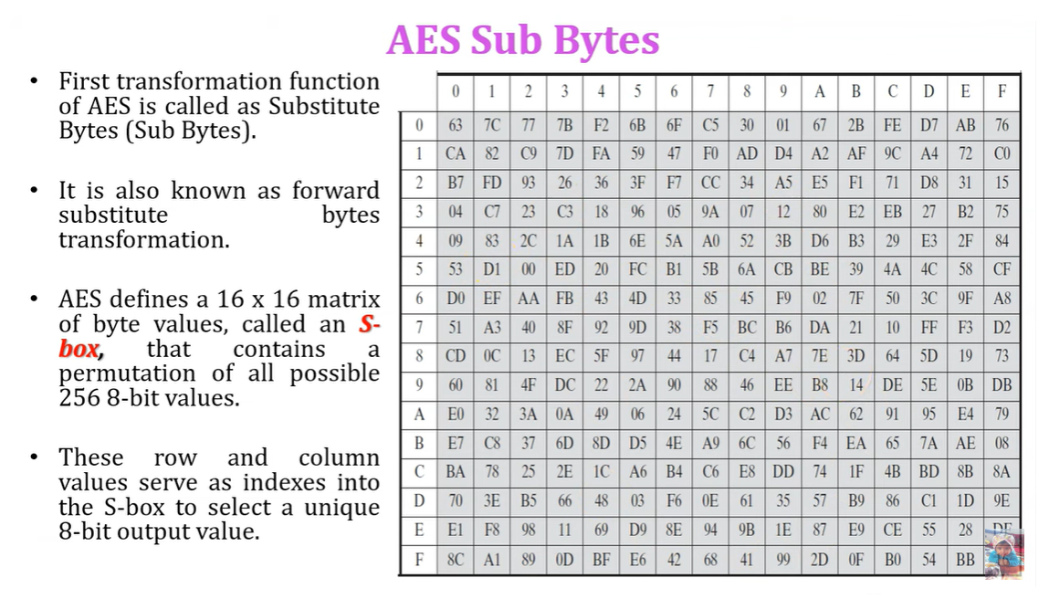

Slide 42
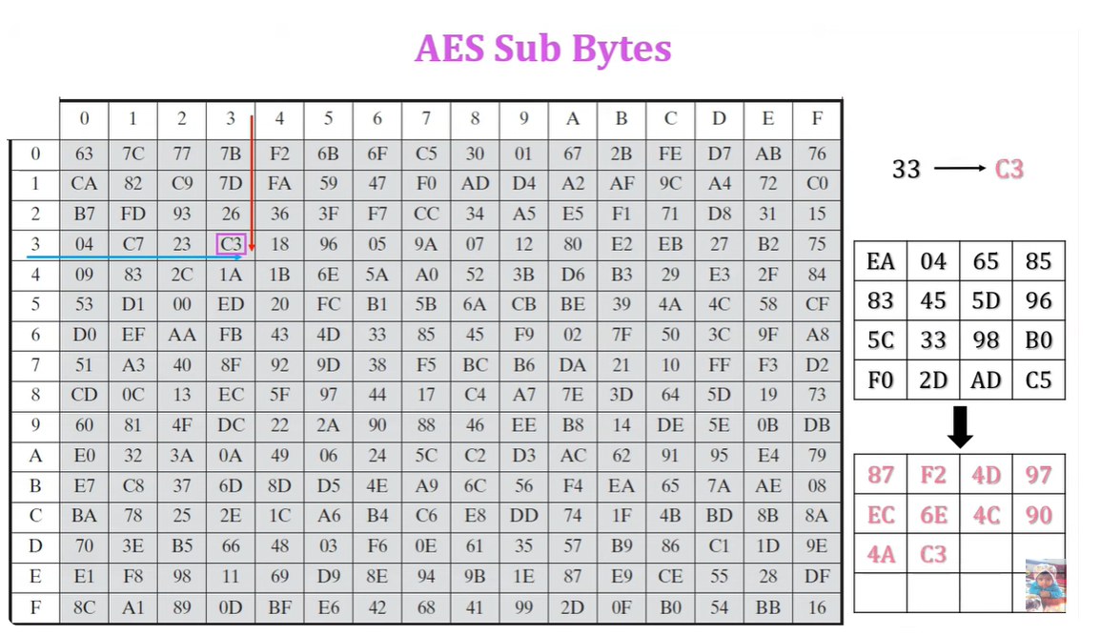

Slide 43
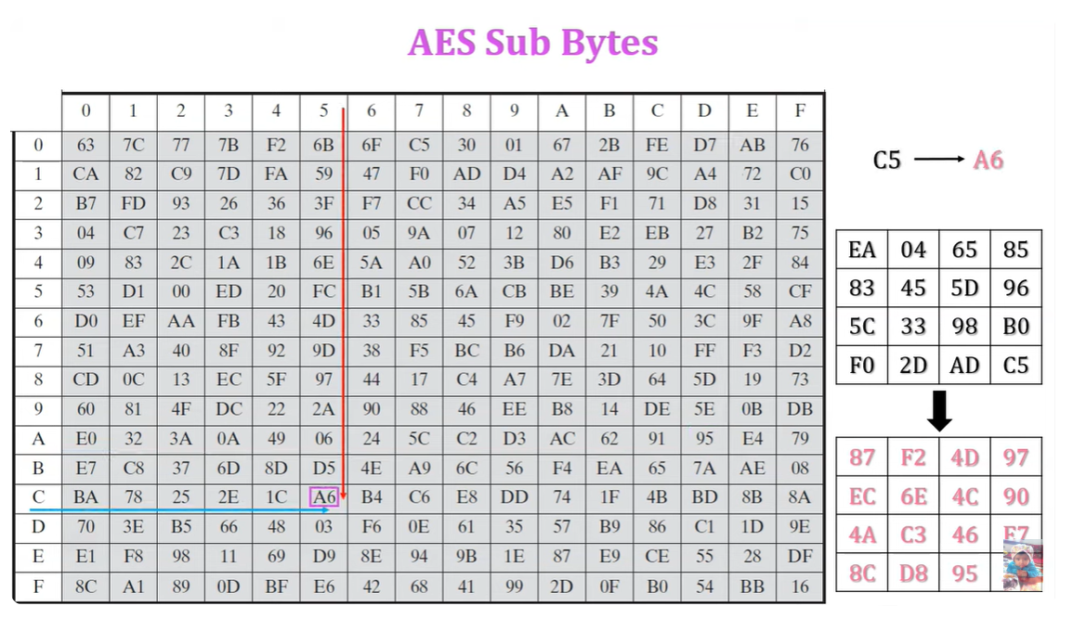

Slide 44
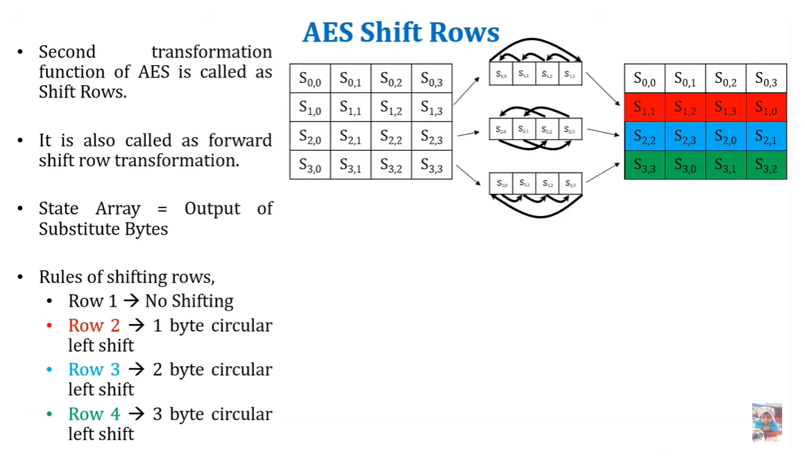

Slide 45
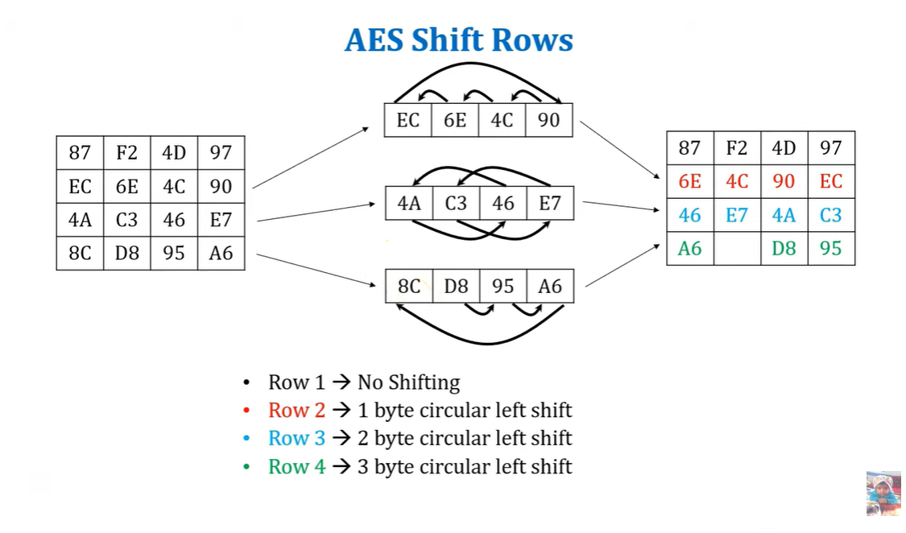

Slide 46
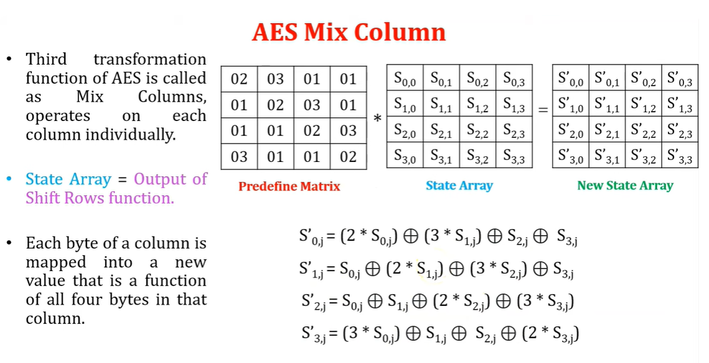
Mix column

Slide 47
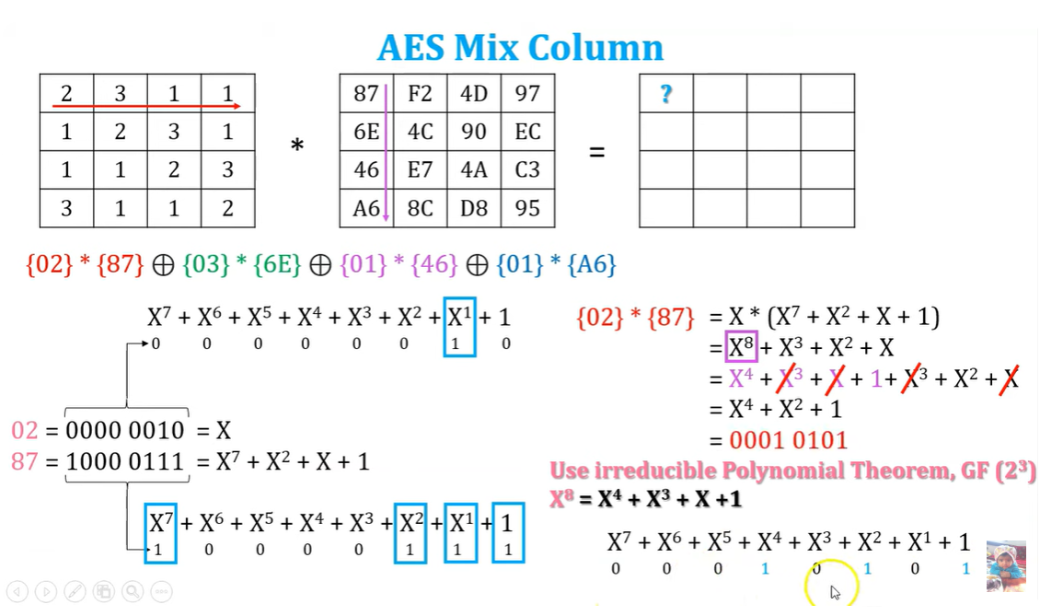
Mix column

Slide 48
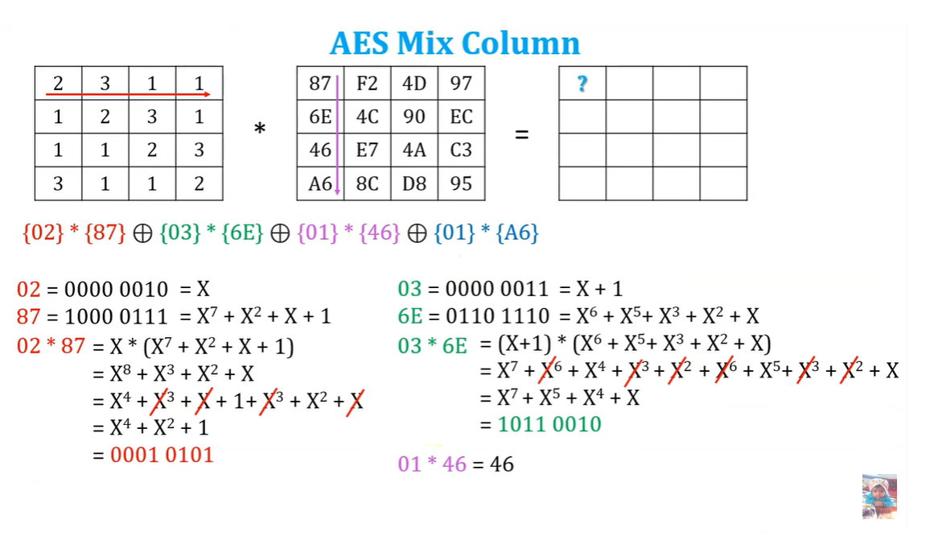
Mix column

Slide 49
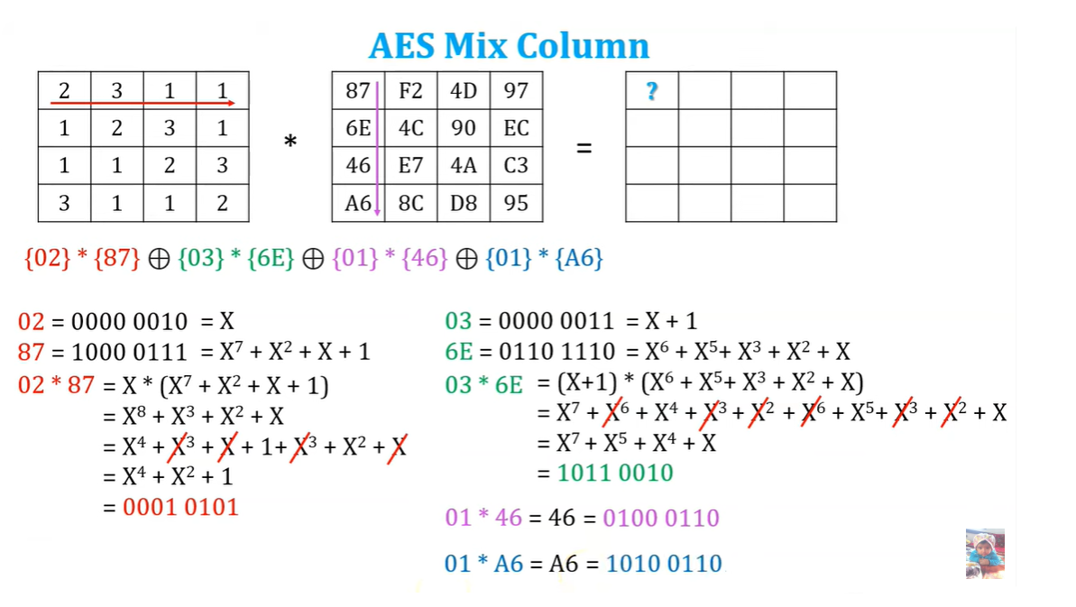
Mix column

Slide 50
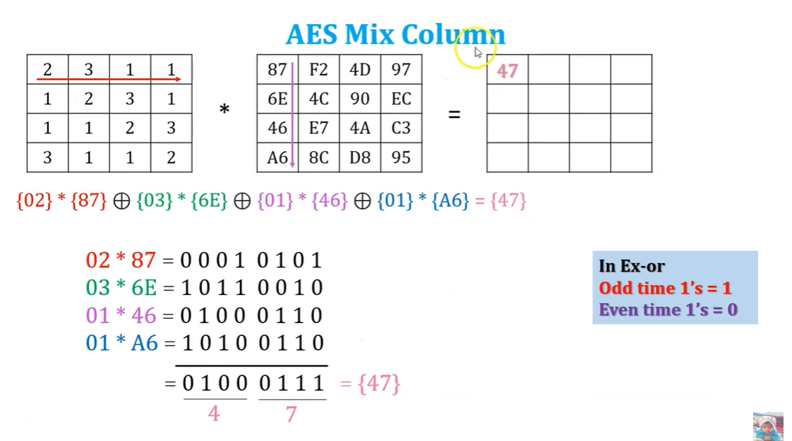
Mix column

Slide 51
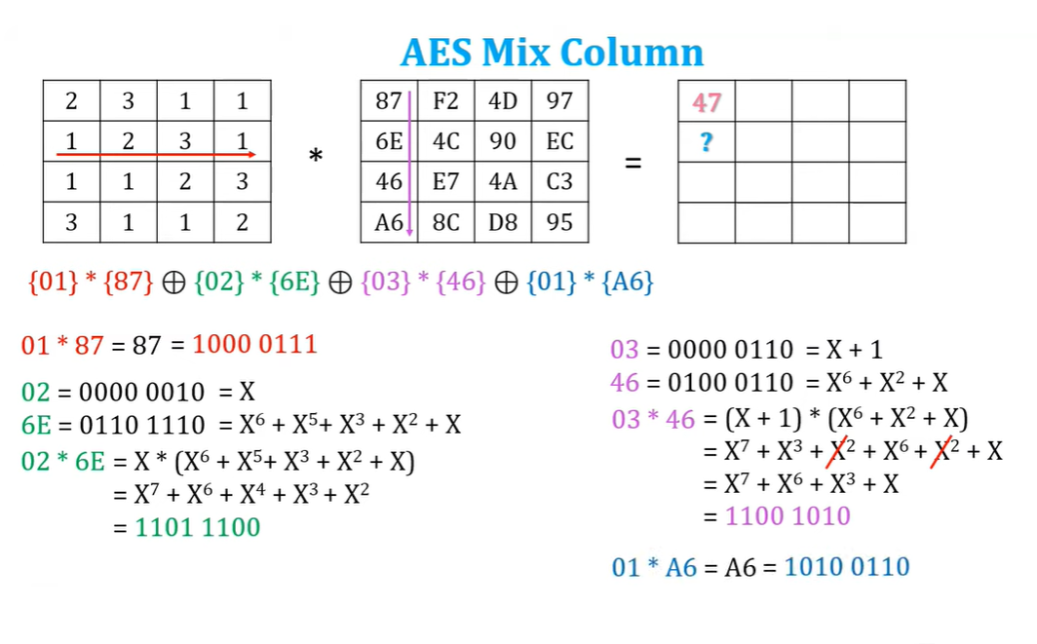
Mix column

Slide 52
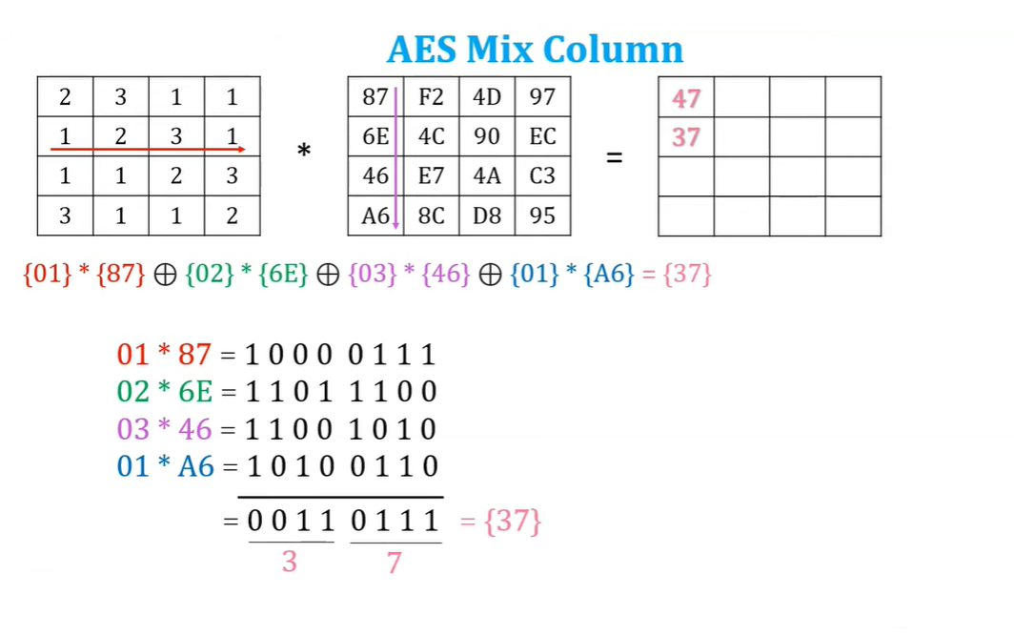

Slide 53
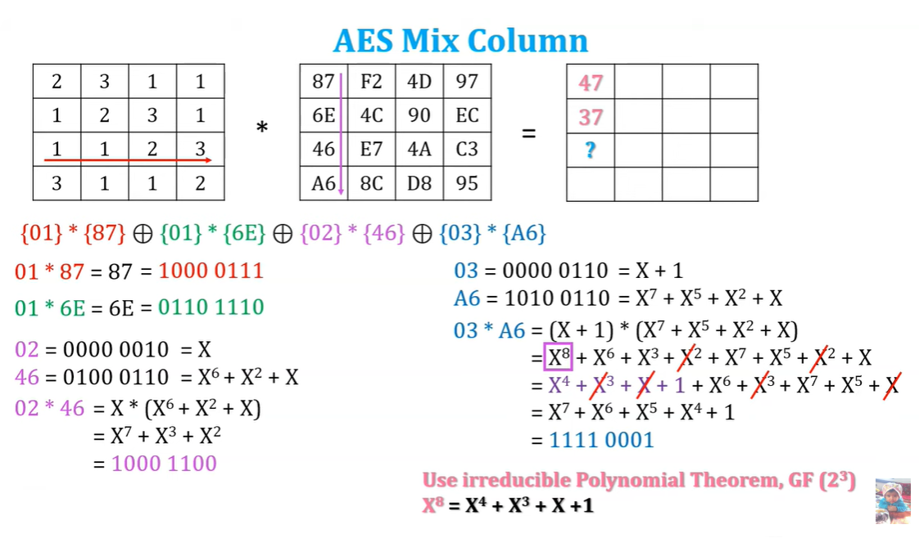
Mix column

Slide 54
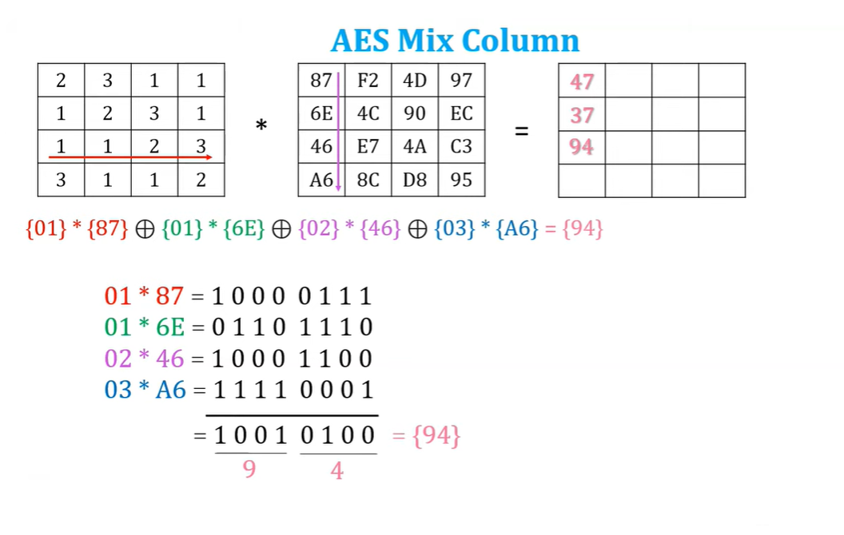

Slide 55
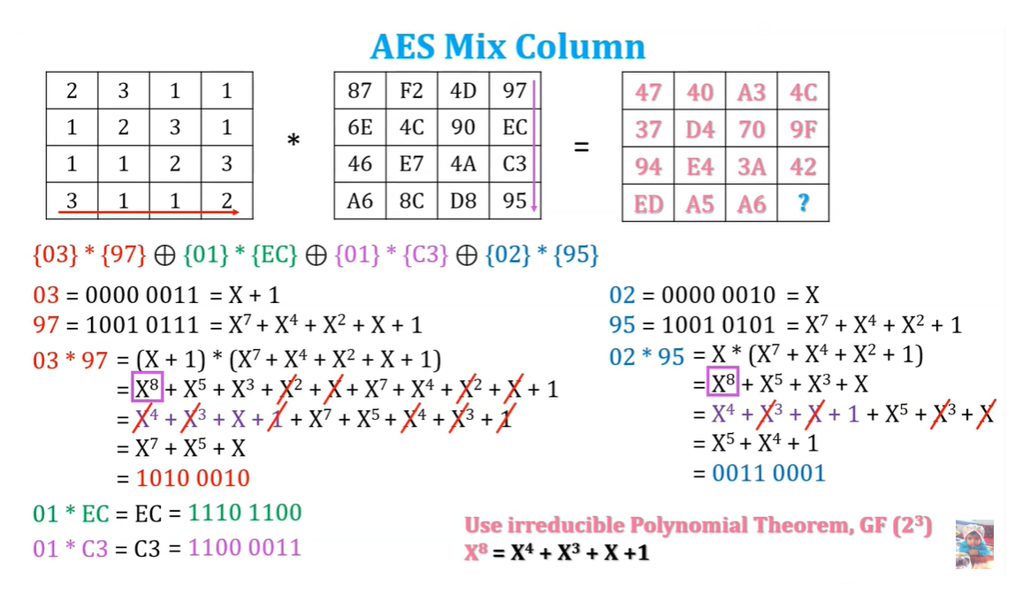
Mix column

Slide 56

Mix column

Slide 57

Mix Column

Slide 59


Slide 60


Slide 61


Slide 62


Slide 63


Slide 64


Slide 65
Simplified AES
In fact, the structure of S-AES is exactly the same as AES. The differences are in the key size (16 bits), the block size (16 bits) and the number of rounds (2 rounds).
Instead of dividing the block into a four by four array of bytes, S-AES divides it into a two by two array of “nibbles”, which are four bits long.
Before the first round, the first two words (W0 and W1) of the expanded key are XORed. In the first round, W2 and W3 are XORed. In the last round, W4 and W5 are XORed.

Slide 66
Simplified AES
S-AES | AES
16-bit key | 128-bit key
16-bit plaintext/ciphertext | 128 bit plaintext/ciphertext
2 rounds | 10 rounds
First with all four operations Last with 3 operations | 9 with all four operations Last with 3 operations
Round key size: 16 bits | Round key size: 128 bits

Slide 67


S-AES Encryption Overview

Slide 68



S-AES Encryption Overview

Slide 69
Simplified AES Example
Lets assume the inputs for the encryption are:
16-bit Plaintext, P: 1101 0111 0010 1000
16-bit Key, K: 0100 1010 1111 0101
AddRoundKey:
P ⊕ K₀: 1101 0111 0010 1000 ⊕ 0100 1010 1111 0101 =
1001 1101 1101 1101
Stage 1: Key Schedule:
1001 | 1101
1101 | 1101
0100 | 1111
1010 | 0101

Slide 70

Simplified AES Example
16-bit Plaintext, P: 1101 0111 0010 1000
16-bit Key, K: 0100 1010 1111 0101
Stage 1: Key schedule:
The input key (K) is split into 2 words:
w₀ = 0100 1010 and w₁=1111 0101
The first sub-key K₀= w₀w₁
The second sub-key k₁ = w₂w₃
The third sub-key k₂ = w₄w₅
Rcon(1)=1000 0000
Rcon(2)=0011 0000

Slide 71

Simplified AES Example
The other sub-keys are generated as follows:
w₂ = w₀ XOR 10000000 XOR SubNib(RotNib(w₁))
RotNib() is “rotate the nibbles”, which is equivalent to swapping the nibbles
SubNib() is “apply S-Box substitution on nibbles using encryption S-Box”

Slide 72
Simplified AES Example
0100 | 1111
1010 | 0101
The other sub-keys are generated as follows:
w₂ = w₀ XOR Rcon(1) XOR SubNib(RotNib(w₁))
w₂ = 0100 1010 XOR 10000000 XOR SubNib(RotNib(1111 0101))
w₂ = (0100 1010 XOR 10000000) XOR SubNib(0101 1111)
w₀ | w₁ | w₂ | w₃ | w₄ | w₅

Slide 73
Simplified AES Example
The other sub-keys are generated as follows:
w₂ = w₀ XOR Rcon(1) XOR SubNib(RotNib(w₁))
w₂ = 0100 1010 XOR 10000000 XOR SubNib(RotNib(1111 0101))
w₂ = (0100 1010 XOR 10000000) XOR SubNib(0101 1111)
w₂ = (1100 1010) XOR 0001 0111 = 1101 1101
w₀ | w₁ | w₂ | w₃ | w₄ | w₅

Slide 74
Simplified AES Example
The other sub-keys are generated as follows:
w₂ = w₀ XOR Rcon(1) XOR SubNib(RotNib(w₁))
w₂ = 0100 1010 XOR 10000000 XOR SubNib(RotNib(1111 0101))
w₂ = (0100 1010 XOR 10000000) XOR SubNib(0101 1111)
w₂ = (1100 1010) XOR 0001 0111 = 1101 1101
w3 = w2 XOR w1 = 1101 1101 XOR 1111 0101 = 0010 1000
w₀ | w₁ | w₂ | w₃ | w₄ | w₅
w4 = w2 XOR Rcon(2) XOR SubNib(RotNib(w3))
w4= (1101 1101 XOR 0011 0000) XOR SubNib(1000 0010)
w4= (1110 1101) XOR 0110 1010 = 1000 0111
w5 = w4 XOR w3 = 1000 0111 XOR 0010 1000 = 1010 1111

Slide 75
Simplified AES Example
The sub-keys are as follows:
K0=
K1=
K2=
0100 | 1111
1010 | 0101
1101 | 0010
1101 | 1000
1000 | 1010
0111 | 1111

Slide 76
Simplified AES Example
Stage 2: Plaintext Encoding: there is an initial operation (Add Round Key), followed by the main Round, followed by the final Round.
AddRoundKey:
P ⊕ K₀: 1101 0111 0010 1000 ⊕ 0100 1010 1111 0101 =
1001 1101 1101 1101
Round1:
Sub-bytes → 0010 1110 1110 1110
ShiftRow → ??
MixColumn→ ??
AddRoundkey→ ??
0010 | 1110
1110 | 1110

Slide 77
Simplified AES Example
Stage 2: Plaintext Encoding: there is an initial operation (Add Round Key), followed by the main Round, followed by the final Round.
AddRoundKey:
P ⊕ K₀: 1101 0111 0010 1000 ⊕ 0100 1010 1111 0101 =
1001 1101 1101 1101
Round1:
Sub-bytes → 0010 1110 1110 1110
ShiftRow → 0010 1110 1110 1110
MixColumn→ ??
AddRoundkey→ ??
0010 | 1110
1110 | 1110
0010 | 1110
1110 | 1110

Slide 78

Simplified AES Example
MixColumn→
(1x2) ⊕ (4xE)= 2 ⊕ D = 0010 ⊕ 1101= 1111
(1xE) ⊕ (4xE)= E ⊕ D = 1110 ⊕ 1101= 0011
(4x2) ⊕ (1xE)= 8 ⊕ E = 1000 ⊕ 1110= 0110
(4xE) ⊕ (1xE)= D ⊕ E = 1101 ⊕ 1110= 0011
1 | 4
4 | 1
2 | E
E | E
X

Slide 79
Simplified AES Example
MixColumn→
(1x2) ⊕ (4xE)= 2 ⊕ D = 0010 ⊕ 1101= 1111
(1xE) ⊕ (4xE)= E ⊕ D = 1110 ⊕ 1101= 0011
(4x2) ⊕ (1xE)= 8 ⊕ E = 1000 ⊕ 1110= 0110
(4xE) ⊕ (1xE)= D ⊕ E = 1101 ⊕ 1110= 0011
AddRoundKey→
1 | 4
4 | 1
2 | E
E | E
X
K1
1111 | 0011
0110 | 0011
1101 | 0010
1101 | 1000
0010 | 0001
1011 | 1011
⊕
=

Slide 80
Simplified AES Example
0010 | 0001
1011 | 1011
Round2:
Sub-bytes → 1010 0011 0100 0011
ShiftRow → 1010 0011 0100 0011
AddRoundkey→ 1010 0011 0100 0011⊕ 1000 0111 1010 1111=
0010 0100 1110 1100
Ciphertext = 0010 0100 1110 1100
K2
1000 | 1010
0111 | 1111

Slide 81
Summary
AES transformation functions
Substitute bytes
ShiftRows
MixColumns
AddRoundKey
AES and S-AES implementation
Implementation aspects
AES structure
General structure
Detailed structure
AES key expansion
Key expansion algorithm
Rationale
Notes:
Chapter 6 summary.

